Slide 1


Introduction to Ethics
KT44102/3
Ethics and Law in ICT
Sem 1: 2022/2023
31 /10/2022

Slide 2
What is ETHICS to you?

Slide 3





Slide 4
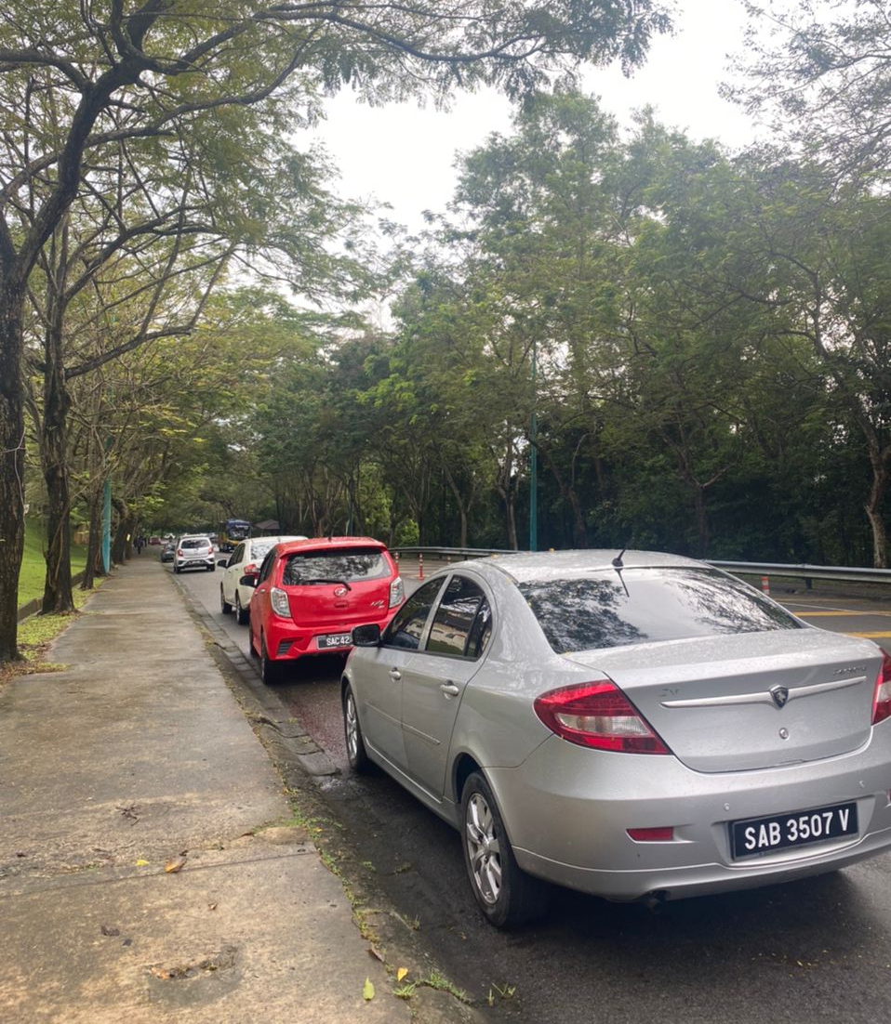

Slide 5
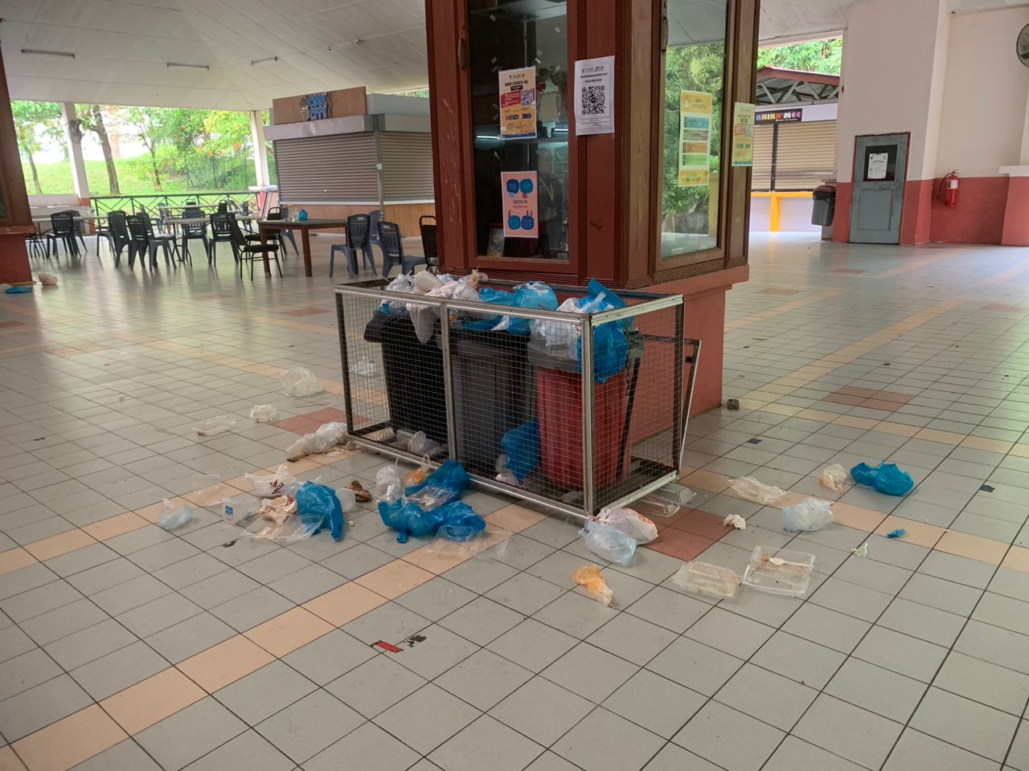

Slide 6
Contents
The Point of View
Terms & Definitions
Why Ethics
The Need Fostering Good Ethics
Ethics Decision Making : Ethical Theory
Ethics in IT

Slide 7
The point of view
2 ways to view world:
Selfish point of view : consider only own self and its core values
Ethical point of view: respect other people and their core values

Slide 8
Defining Term
Society
Association of people organized under a system of rules
Rules: advance the good of members over time
Virtual society - Netizen
Community
A group of people living in the same place or having a particular characteristic in common
Subset of society
Virtual community (share interest and goal)

Slide 9
Defining Term
Moral Code
Set of rules
Establishes boundaries of generally accepted behavior
Different rules often have contradictions
Morality
Social conventions about right and wrong
Widely shared
Form basis for an established consensus
May vary : Age, culture, background, life experience, gender ……

Slide 10
Defining Term
Ethics
Set of beliefs about right and wrong behavior within a society
Rational examination of morality – evaluation of people’s behaviors
Virtues
Habits that incline people to do what is acceptable
Vices
Habits of unacceptable behaviors
Virtues and vices define a personal value system (scheme of moral value)

Slide 11
Defining Term
Integrity
1)The state of being whole and undivided, 2) the quality of being honest and having strong principles.
Cornerstone of ethical behavior
With integrity:
Act accordance with a personal code of principles
Extend to all same respect and consideration
Apply the same moral standards in all situation
Lack of integrity : apply moral standards differently according to situation or people involved
Many ethical dilemmas are not as simple as right vs wrong

Slide 12
The Difference Between Morals, Ethics, and Laws
Moral: people ought/ought not to do, personal beliefs about right and wrong
Ethics: standards/ codes of behavior expected by a group – generated from examination of people behaviors.
Law: system of rules that tells us what we can and cant do
Enforces by a set institutions
Legal acts conform the law
Moral acts conform to what an individual believes is the right belief of right and wrong.

Slide 13
Why Ethics
The likelihood and the negative impact of inappropriate behavior have increased
Several trends have increased the likelihood of unethical behaviors:
Globalization - create complex environments
Organization challenged to maintain profits/revenue
New technology
Affect everyone – find ourselves in the middle of an ethical dilemma
Example : recent scandals in involving IT and ICT ???

Slide 14
The Need Fostering Good Ethics
To gain the good will of the community
Through social responsibility (donation, funding, benefits for employees).
To create an organization that operates consistently
Know what can be expected.
Sharing values: honesty, integrity, according standard, treat with respect, value diversity, facts and principles decision making and strive to excel.

Slide 15
The Need Fostering Good Ethics
To foster good practices
Operate in a fair and ethical manner
To protect organization/employees from legal action
To avoid unfavorable publicity
Public reputation

Slide 16
Ethics Decision Making
The steps
Develop problem statement
Clear, concise description of the issues
Most critical step
The questions: what cause, who affected, how often, what impact, and how serious
Identify alternative
Evaluate and choose alternative
Implement decision
Timely, awareness (power of communication) and transition plan
Evaluate results
Monitor the desired effect, observe the impact, further refinements (if)
Success
Ethical Theories

Slide 17
Ethical Theories (Non-workable)
Relativism
Subjective Relativism
Culture Relativism
Divine Command Theory
Ethical Egoisms

Slide 18
Non- Workable Theories
Relativism
No universal norms of right and wrong
One person can say “X is right” another can say “X is wrong”, and both can be right.
Subjective relativism (SR)
Each person decides right and wrong for/based on himself or herself
“What’s right for you may not be right for me”
Pro: Ethical debates are disagreeable and pointless
Con: Blurs distinction, not based on reason and SR and tolerance are 2 difference things

Slide 19
Non- Workable Theories
Culture Relativism (CR)
What is “right” and “wrong” depends upon a society’s/culture’s actual moral guidelines
These guidelines vary from place to place and from time to time
A particular action may be right in one society at one time and wrong in other society or at another time
Pro:
Different social contexts demand different moral guidelines
It is arrogant for one society to judge another
Con:
Some culture share moral views
What if there is “Culture in conflict”
Indirect based on reason

Slide 20
Non- Workable Theories
Divine Command Theory (DCT)
Good actions: those aligned with God’s will
Bad actions: those contrary to God’s will
Holy books reveal God’s will
We should holy books as moral decision-making guides
Pro:
We owe obedience to our Creator
God is all-good, all-knowing and the ultimate authority
Con:
Different holy book and some moral problem not addressed in scripture
Based on obedience, not reason

Slide 21
Non- Workable Theories
Ethical Egoism (EE)
Each person should focus exclusively on his or her self-interest
Morally right action: that action that provides self with maximum long-term benefit
Pro:
The community can benefit when individuals put their well-being first
Other moral principles are rooted in the principle of self-interest and it is practical since we are already inclined to do what’s best for ourselves
Con:
Not true that people naturally act in their own long-term self-interest
Social injustices have occurred when individuals have put their own interests first

Slide 22
Workable Theories
A Good Ethical Theory Supports Persuasive, Logical Arguments

Slide 23
Workable Theories
Kantianism
Reason should cultivate desire to do right thing
Immanuel Kant: Only thing in the world that is good without qualification is a good will
Pro:
Aligns with common moral concern → produce universal moral guideline
Treats all persons as moral equals.
Con:
Sometimes no rule adequately characterizes an action
Sometimes there is no way to resolve a conflict between rules
Kantianism allows no exceptions to perfect duties

Slide 24
Workable Theories
Perfect duty (PD): duty obliged to fulfill without exception
Example: Telling the truth
Imperfect duty(ID): duty obliged to fulfill in general but not in every instance
Example: Helping others
PD vs ID = PD
PD vs PD = ???

Slide 25
Workable Theories
Kantianism Analysis
Issue: Carla a single mother has a full-time job and is taking 2 evening courses per semester in order her to complete her college education. One of her course requires more work than normal. Carla doesn’t have time to write the final report and purchases a report from the Web that sells term papers and submit it as her own work. Was Carla’s action morally Justifiable?
Categorical Imperative (1st Formulation) Act only from moral rules that you can at the same time will to be universal moral laws. Analysis Proposed rule: Get credit from others’ work Universalize rule: plagiarism, cheating = NO Evaluation: Against universalize rule If proposed rule is allowed, question the credibility of student (Carla) skills & Knowledge Conclusion: Wrong Professor should not give credit(grade) This self-defeating give Impact to society and Organization | Categorical Imperative (2st Formulation) Act so that you treat both yourself and other people as ends in themselves and never only as a means to an end. Analysis 3rd party: The professor End (the aim): Passing the course Associated action: Deceive the professor by submitting work as her but actually other’s work that she purchased it from web. Prove the means : Yes – treated her professor as an means to an end (deceive ding her professor) Conclusion: Wrong Should communicate with her professor about the circumstances

Slide 26
Workable Theories
Utilitarianism
Based on consequence –action chosen if it has best overall consequence
Find the greatest good by balancing all interest
Cost-benefit analysis
Act Utilitarianism
Rule Utilitarianism

Slide 27
Workable Theories
Act Utilitarianism (AU)
Utility: tendency of an object to produce happiness or prevent unhappiness for an individual or a community
An action is right (or wrong) to the extent that it increases (or decreases) the total happiness of the affected parties.

Slide 28
Workable Theories
AU applies the principle of utility to individual moral actions
Pro:
Happiness
Practical and comprehensive
Con:
What should be include in calculations (subjective) – not clear where to draw the line
Not practical to put so much energy into every moral decision
Ignore our innate sense of duty
We cannot predict consequences with certainty
Susceptible to the problem of moral luck.

Slide 29
Workable Theories
AU Analysis
Issue A state is considering replacing a curvy stretch of highway that passes along the outskirts of a large city. Would building the highway be a good action?
Analysis Benefit (Happiness) Save drivers $6K per weekday, * highway operation 25 years $39M TOTAL $39M | Cost (Unhappiness) Compensation homeowners $20M Taxpayers $10M Lost habitat Animal $1M TOTAL $31M
Conclusion Benefits > Cost Building the highways would be a good action Impact to society (positive should be included)

Slide 30
Workable Theories
Rule Utilitarianism (RU)
We ought to adopt moral rules which, if followed by everyone, will lead to the greatest increase in total happiness.
applies Principle of Utility to moral rules
Alternative to AU – not all need utilitarian calculus.
Pro:
Moral rules survive exceptional situations.
Avoid the problem of luck and problem of bias
Appeals to wide cross-section of society
Con:
Similar “sum” , how to quantify the value of a human life??
Ignore the problem of unjust.

Slide 31
Workable Theories
RU Analysis
Issue computers running the Windows 2000, Windows NT, and Windows XP operating systems. The Blaster worm caused computers it infected to reboot every few minutes. To solve the problem new worm Nachi, was benevolent was released. Was action of releasing the Nachi worm morally right or wrong?
Analysis Proposed rule : Write and release a helpful warm that improve the security computer it infects
Benefits (Happiness) –Who and what would benefit People who do not keep their systems updated - automatically removed their network vulnerabilities | Harms (Unhappiness) –Who and what would benefit People use network – they affected because new worm disable network and creating a lot of extra network traffic. People computer infected by Blaster worm - a chance of the new worm accidently harm data/program infected computer System Administrators – extra work to combat every new worm
Conclusion Benefits <Harms Writing and releasing new worm Nachi is morally wrong Impact to society (positive should be included)

Slide 32
Workable Theory
Social Contract Theory (SCT)
“Morality consists in the set of rules,
governing how people are to
treat one another, that rational
people will agree to accept, for their
mutual benefit, on the condition that
others follow those rules as well.”
Establishment of moral rules to govern relations among citizens
Government capable of enforcing these rules
In ideal society, no one above rules
That prevents society from enacting bad rules

Slide 33
Workable Theory
Kind of Rights
Negative right: A right that another can guarantee by leaving you alone
Positive right: A right obligating others to do something on your behalf
Absolute right: A right guaranteed without exception
Limited right: A right that may be restricted based on the circumstances
Positive rights tend to be more limited
Negative rights tends to be more absolute

Slide 34
Workable Theories
Pro:
It is framed in the language of right
Explains why people act in self-interest in absence of common agreement
Provides clear analysis of certain citizen/government problems (control).
Con:
Did you sign the contract?
Some actions have multiple characterizations
Does not explain how to solve a moral problem when involve conflicting rights
May unjustly treat people incapable of upholding contract

Slide 35
Workable Theories
SCT Analysis
Issue Company collects information about customer from the credit card transaction. Then, constructs profiles of customers and sells the profiles to direct marketing firms. Some customers happy to received more e-email, others unhappy at increase in “junk mail”.
Analysis Check if there is any violation of right? What kind of right? (privacy right) Consider the right all parties involved (company, customer, email order company) Identify who owns the information Identify if customer have right to expect their information be kept confidential Evaluate If the right of company == customer , so company did not nothing wrong Else (Customer expect information to be confidential), s0 company wrong. Argument If Company wrong (argue using the law, “Personal Data Protection Act 2010)
Conclusion Emphasize the result Impact to society

Slide 36
Workable Theories

Slide 37
Ethics in IT
IT/ICT Overview
Information technology (IT) refers to devices used in the creation, storage, manipulation, exchange, and dissemination of data, including text, sound, and images and etc.
The cost of IT devices continues fall while their capabilities continue to .
Thus, it create new issues that need to be resolved and a few of the questions raised by the growth of IT.

Slide 38
Ethics in IT
The general public does not understand the critical importance of ethics as applied to IT.
Important decisions are often left to technical experts.
IT manager must assume greater responsibility for the decision by:
Making decisions based on technical savvy, business know-how, and a sense of ethics
Creating an environment where ethical dilemmas can be discussed openly objectively, and constructively

Slide 39
Ethics in IT
The concern about ethics in IT/ICT
Email and Internet access monitoring
Downloading in violation of copyright laws
Spam
Hackers and identify theft
Online plagiarism
Cookies and spyware
Cyberbully/Cyberstalking

Slide 40
Ethics in IT
Goals
To educate people about the tremendous impact of ethical issues in the successful and secure use of information technology
To motivate people to recognize these issues when making business decisions
To provide tools, approaches, and useful insights for making ethical decisions

Slide 41
– 끝 –
– 수고했어요! –
감사합니다.

Slide 42
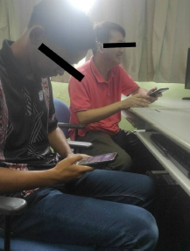
Let's Discuss

Slide 43
Let’s Discuss
Internet Addiction
Fake Account

